Slide 1
Presented by:- Abhigyan Maji
ID:- 30382 Date:- 25th July 2025
Purpose:- Show and Tell

Slide 2
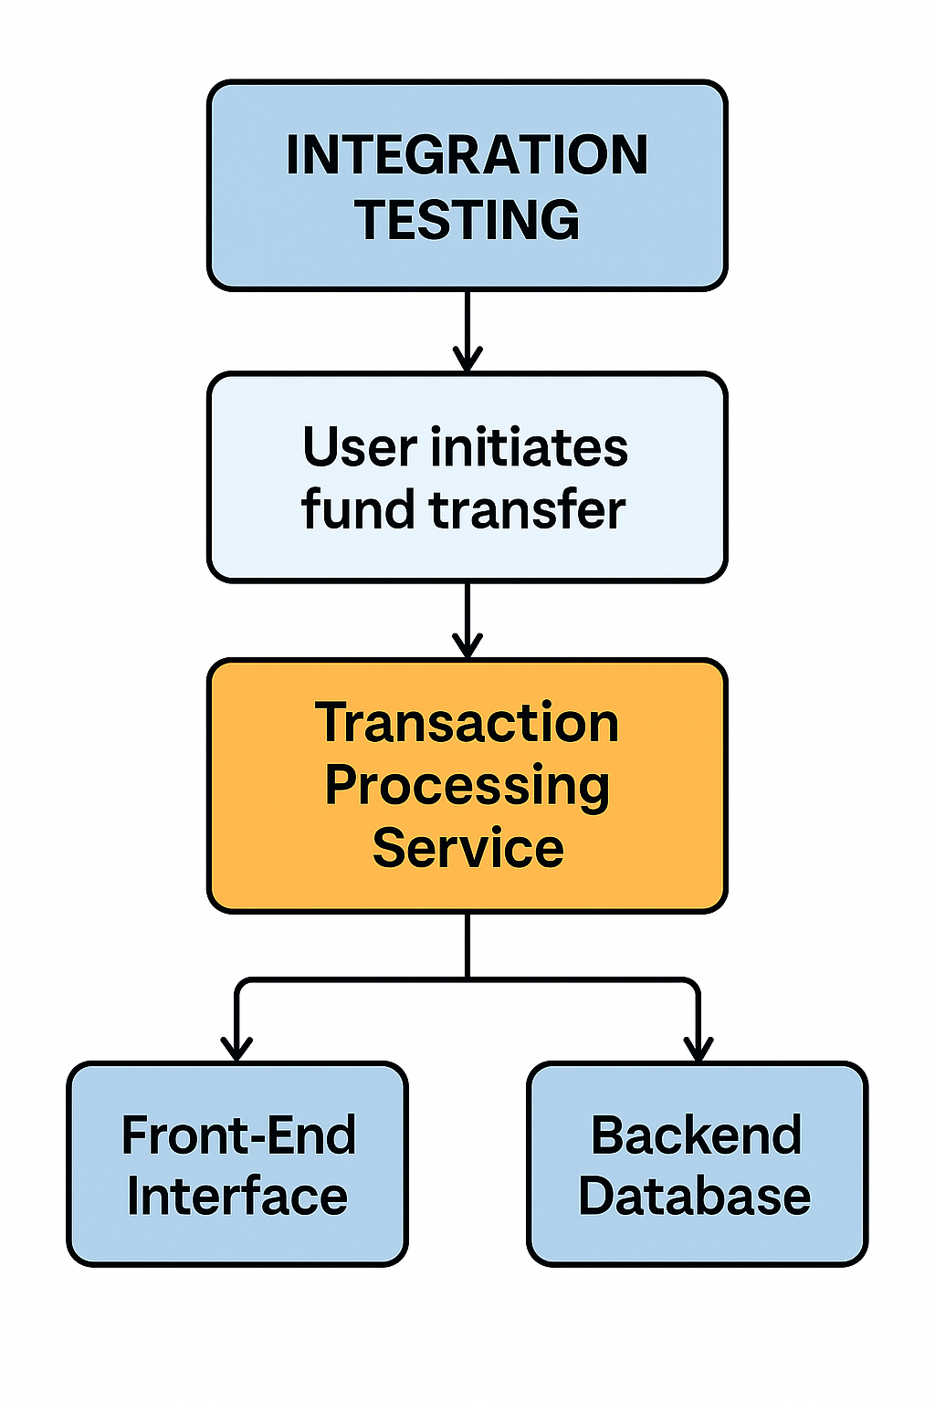
1. What is the Purpose of Integration Testing?
Ans:- Integration testing is known as the second level of the software testing process, following unit testing. Integration testing involves checking individual components or units of a software project to expose defects and problems to verify that they work together as designed. Purpose of Integration Testing:-
Identifying Integration Issues: Integration testing specifically targets problems that emerge when modules are integrated. These can include data inconsistencies, communication errors, or unexpected behavior when different parts of the system interact.
Ensuring Correct Functionality: The core goal is to confirm that the integrated system meets the specified requirements and behaves as expected, not just as individual modules.
Early Bug Detection: By identifying issues early in the development process, integration testing helps reduce the cost and effort associated with fixing them later, during system testing or even after deployment.
Building Reliable Systems: Integration testing is crucial for creating robust and reliable software applications, particularly those with multiple modules or complex interactions.
For example:- In a banking application, integration testing involves checking the interaction between the front-end interface, transaction processing service, and the backend database. When a user initiates a fund transfer, the test ensures that the transaction is processed, account balances are updated correctly, and the transaction details are recorded consistently across all integrated components.

Slide 3
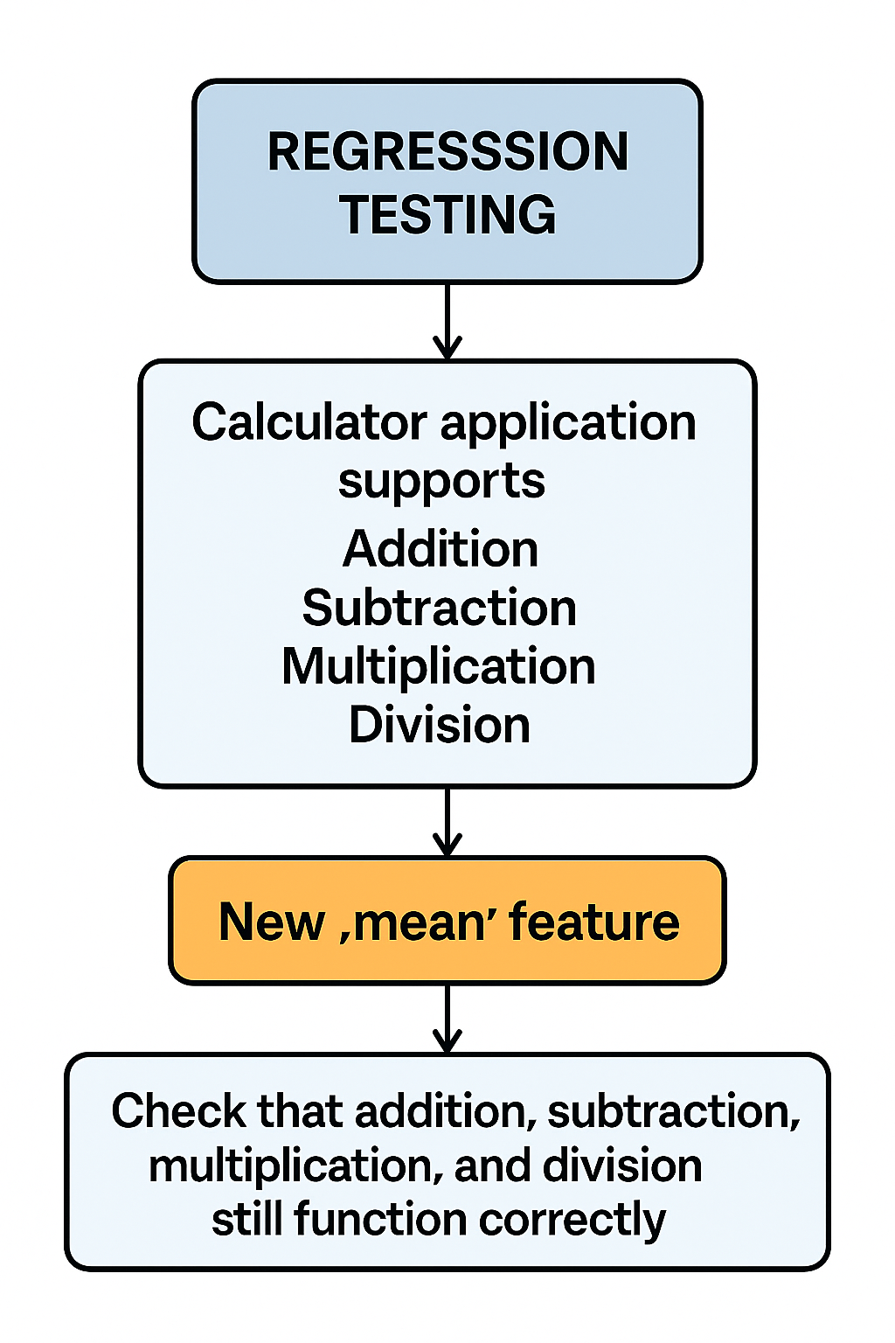
2. What do mean by Regression Testing to give one example?"
Ans:- Regression testing is the process of re-running test cases to ensure recent code changes have not broken existing functionality.
When to Perform Regression Testing
After bug fixes
After adding new features
After performance improvements
During continuous integration cycles
For example, a calculator application supports addition, subtraction, multiplication, and division. After introducing a new “mean” feature, regression testing involves checking that addition, subtraction, multiplication, and division still function correctly, ensuring that the new mean functionality has not impacted the existing operations
Thank you

